Slide 1
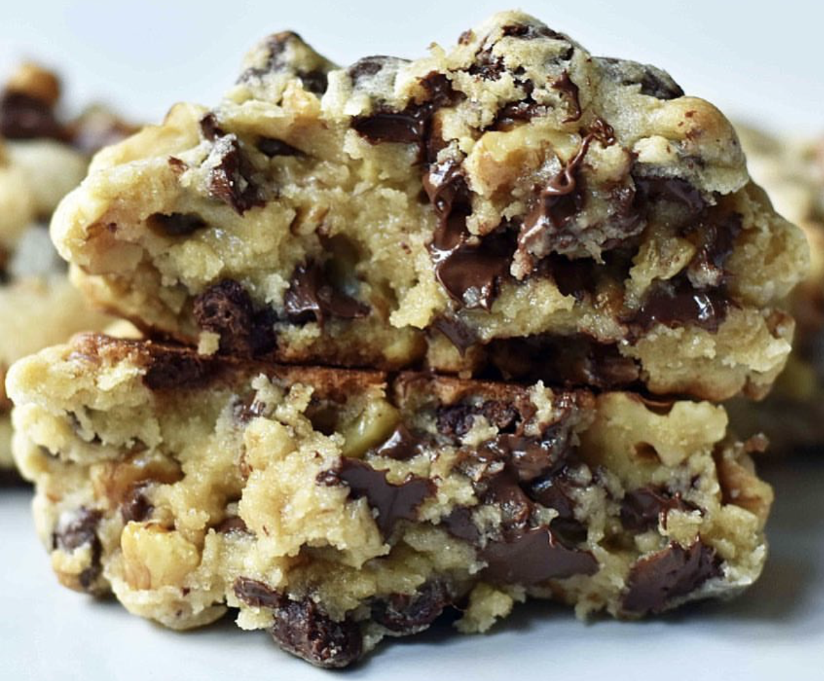
THE PERFECT
CHOCOLATE CHIP COOKIE
Predicting Recipe Ratings
using Linear Regression
Winston Ma
Notes:
We all love chocolate chip cookies

Slide 2
OVERVIEW
Notes:
My client is a struggling bakery who is trying to figure out what are the components of a great chocolate chip cookie recipe?

Slide 3
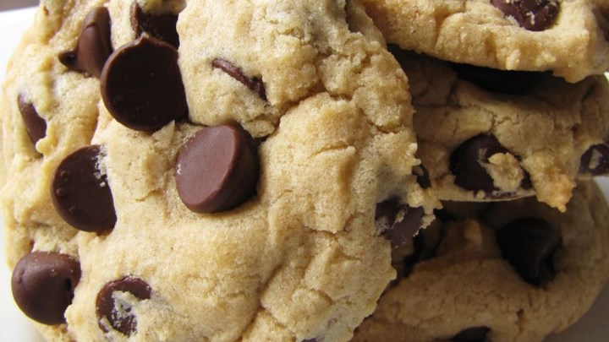
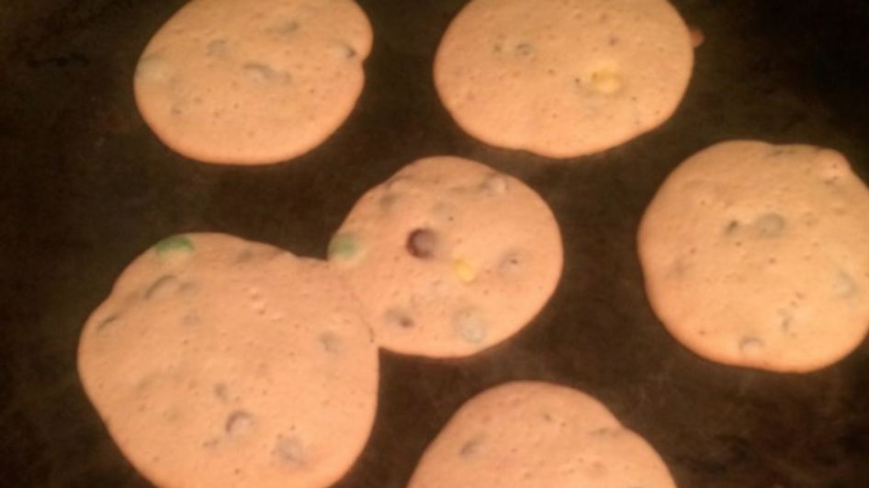
SUGAR, SPICE, AND EVERYTHING NICE…
“…LIFE CHANGING!! …the right balance of flavor and texture.”
“…way too little flour for the amount of shortening and butter.”
Notes:
These are real reviews from allrecipes.com
cookie recipes that are amazing
recipes that fall flat
My client wants to know what components of a chocolate chip cookie recipe that make it popular.

Slide 4
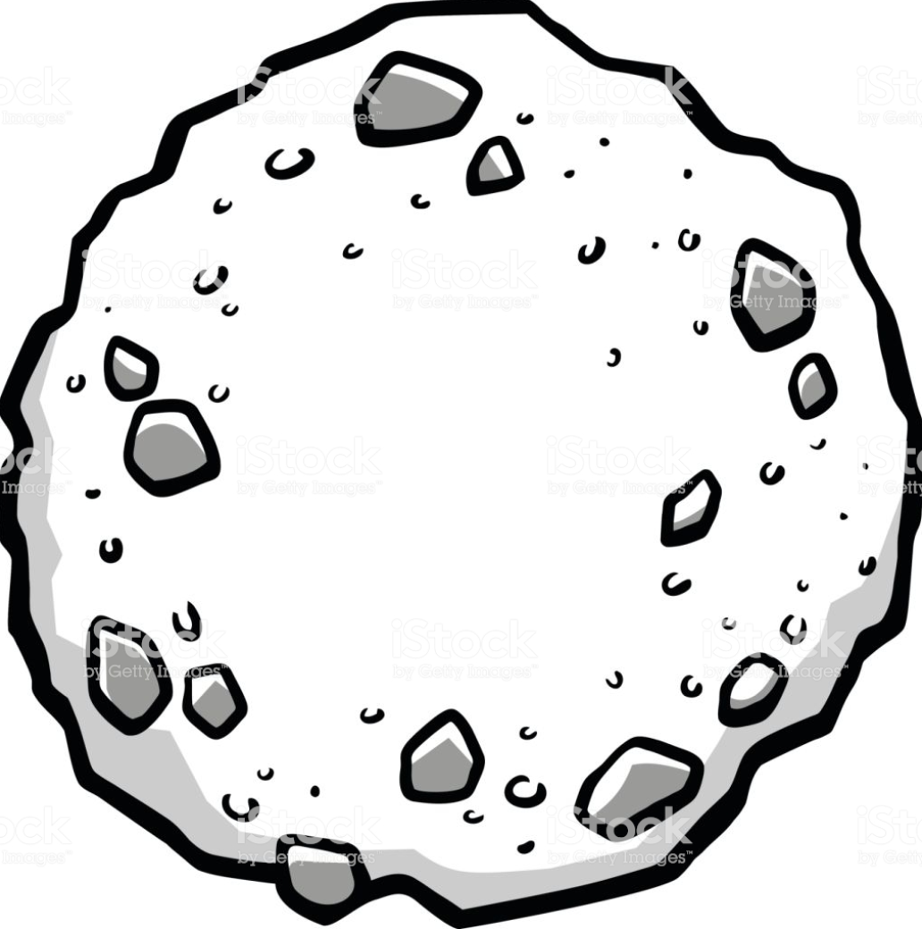
OBJECTIVE
=
?
?
?
?
?
Notes:
In other words, the objective is, if my client were to give me their chocolate chip cookie recipe, would I be able to predict its potential rating?

Slide 5
METHODOLOGY

Slide 6
METHODOLOGY
Explore Data
BeautifulSoup, Selenium
allrecipes.com
Engineer features
Scikit-learn
Linear Regression
LASSO/Ridge Regression
Scrape
Model
Notes:
allrecipes.com has strongest online community with over 750k recipes and 85 million users

Slide 7
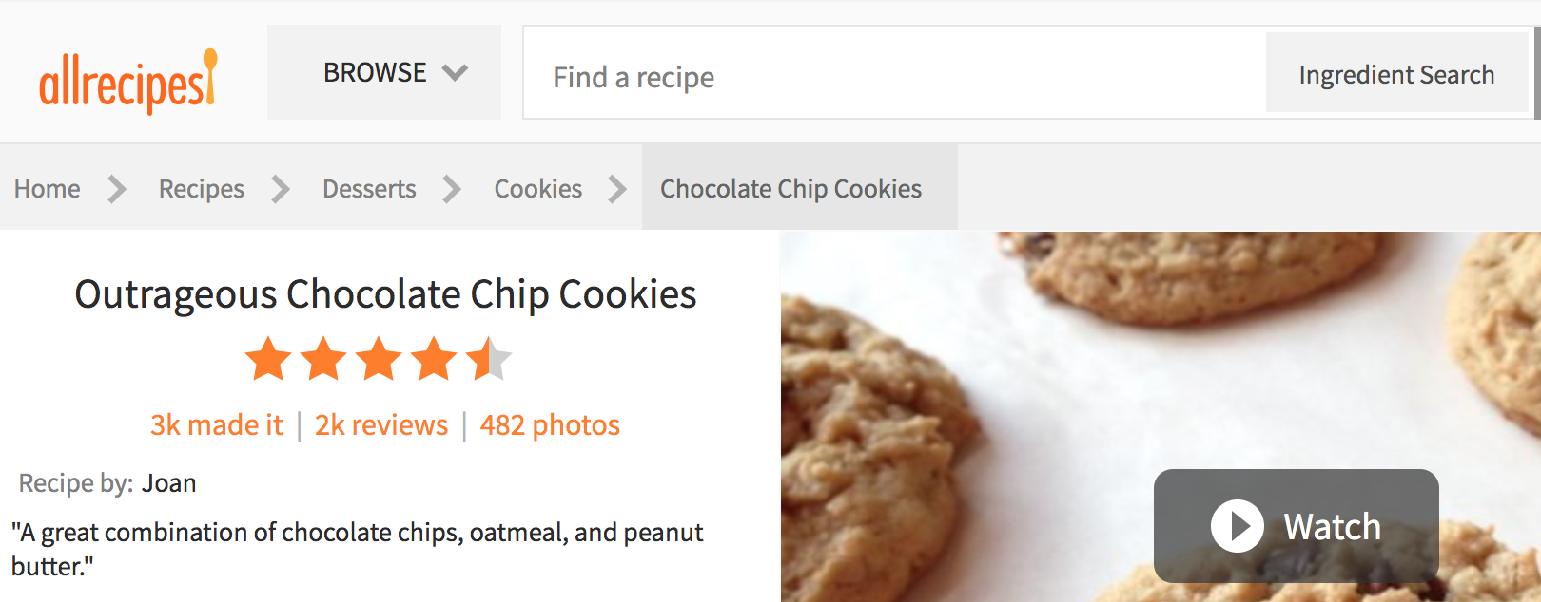
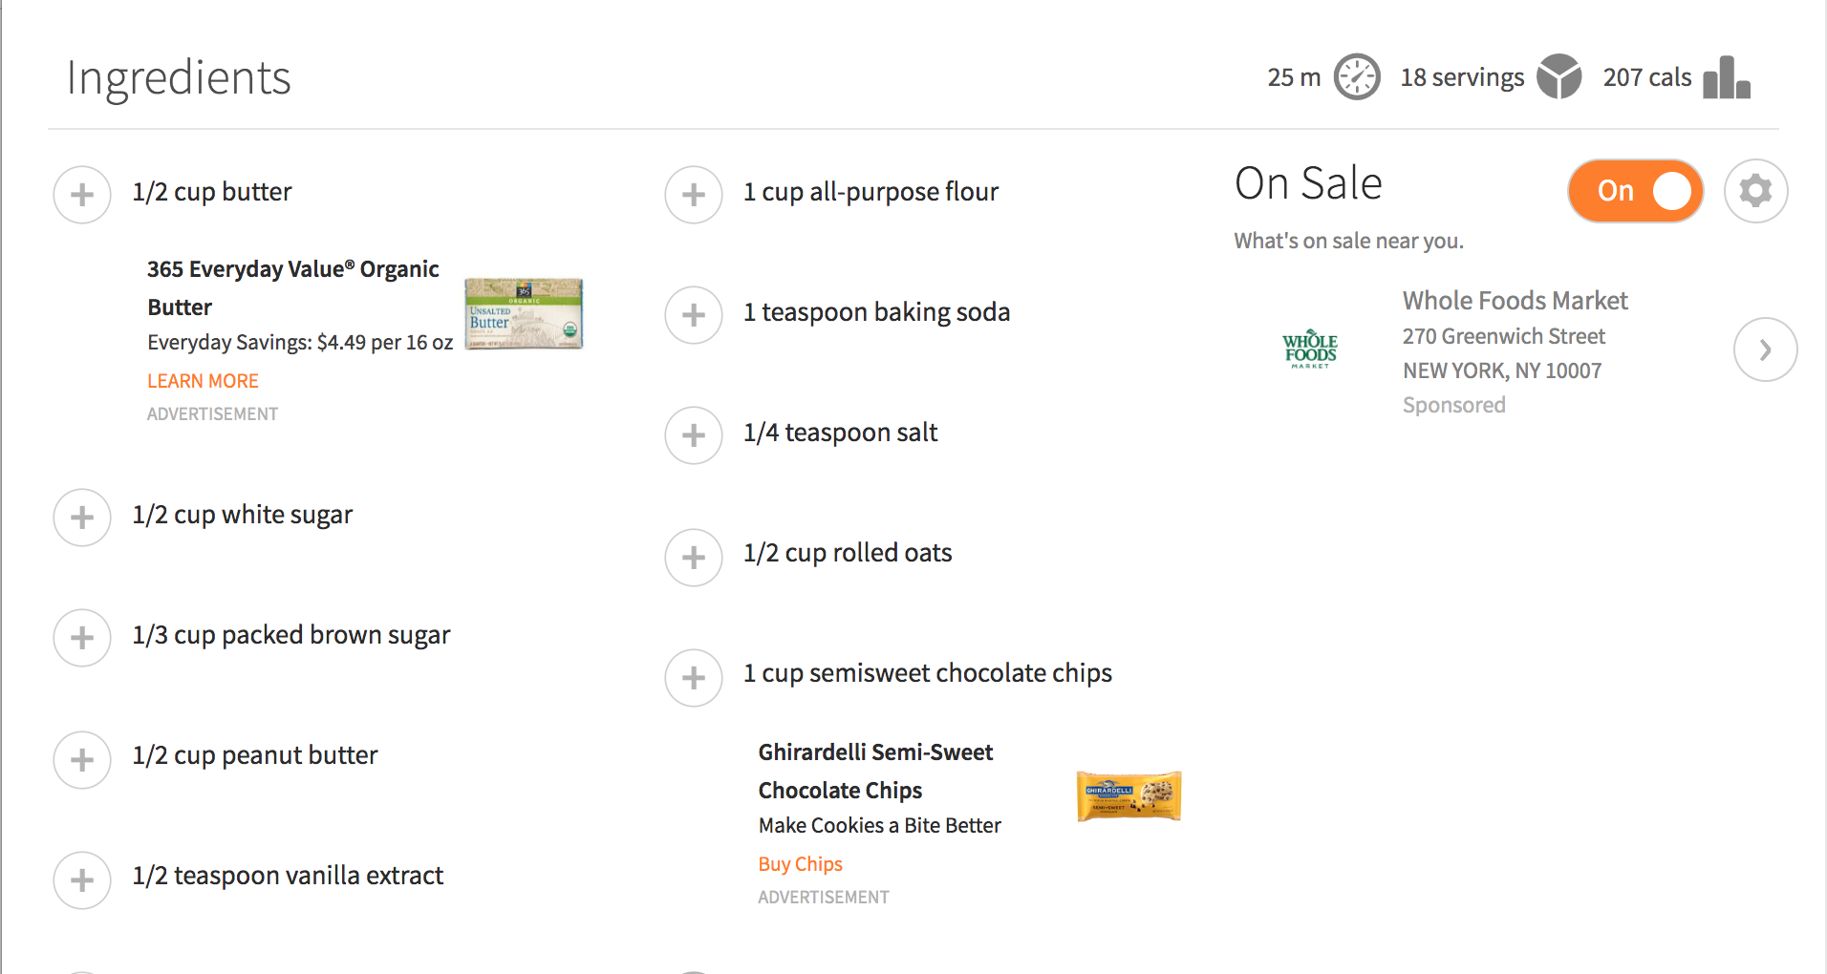
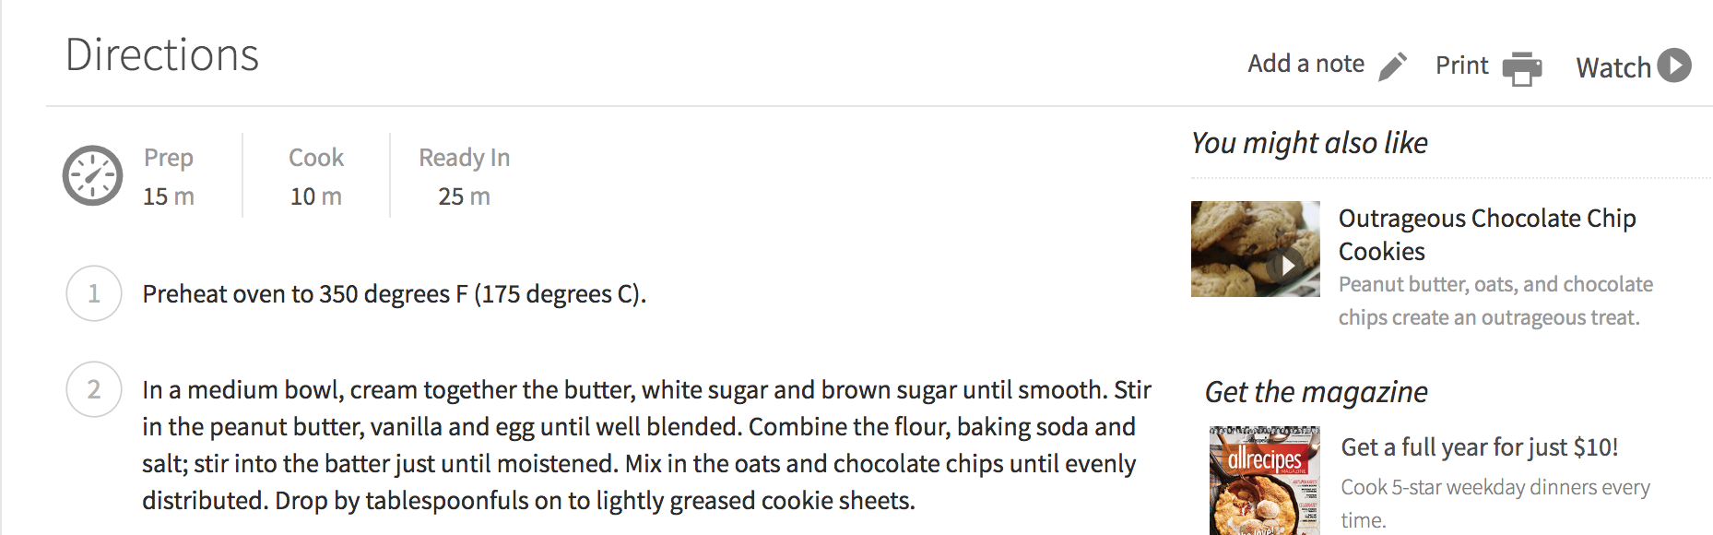
SCRAPED FEATURES
TARGET: Rating
Popularity:
Number of ratings
Number of reviews
Number of photos
Ingredients (grams):
Butter
Flour
White Sugar
Brown Sugar
Chocolate Chips
Etc.
Recipe Description:
Preparation time
Servings per recipe
Calories per serving
Recipe Instructions:
Oven temperature

Slide 8
ENGINEERED FEATURES
“Fantastic texture and balance…I used half butter and half shortening for the fat and they came out perfect!”
”waaaaayyyy too sweet!!!!! …cut the sugar and replace with brown sugar!!
“…way too little flour for the amount of shortening and butter.”
EXAMPLES
Cost per recipe (external effect)
Total number of ingredients (complexity)
Combined ingredient types:
Fats (butter, shortening)
Contains nuts (categorical)
Created ingredient ratios:
White sugar : brown sugar
Fats : flours

Slide 9
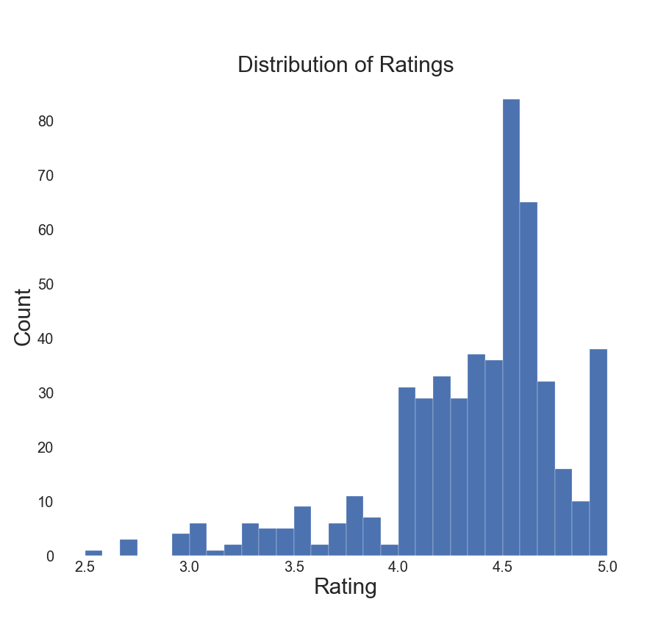
TARGET VARIABLE DISTRIBUTION
Mean: 4.3
Standard Deviation: 0.6

Slide 10
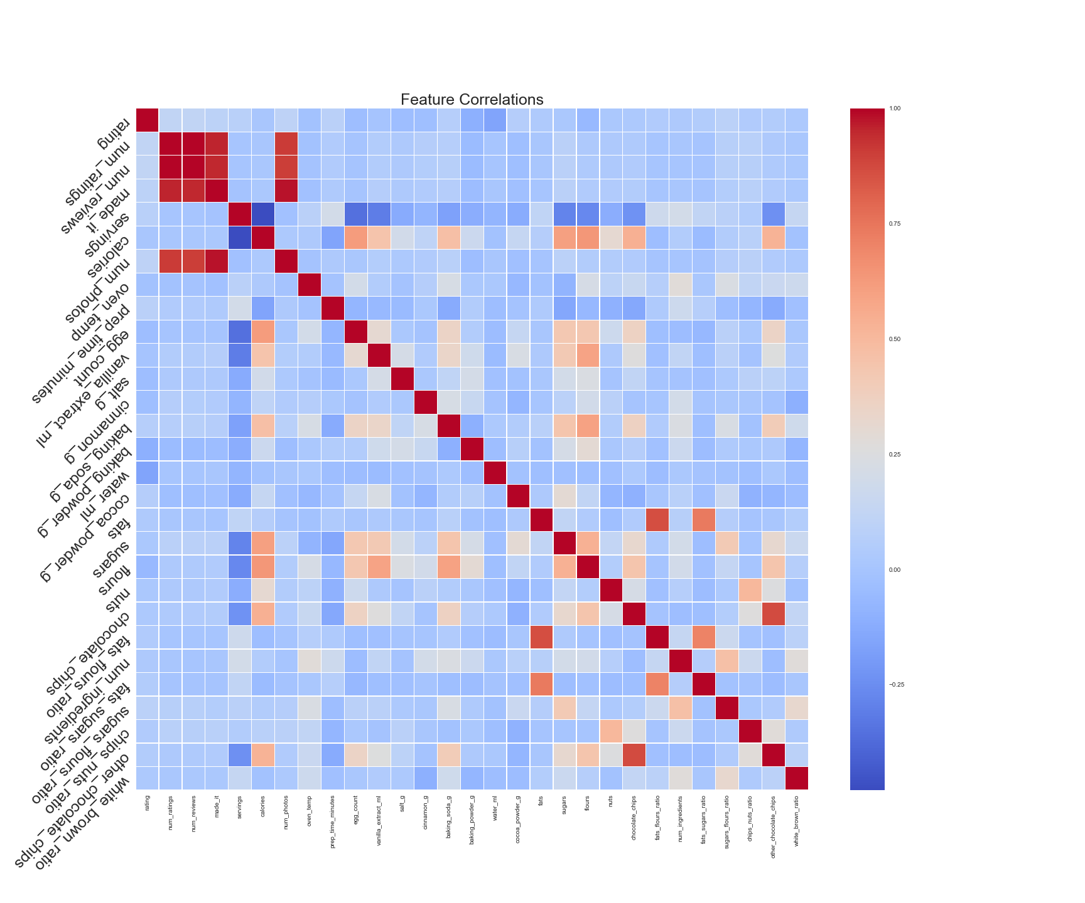
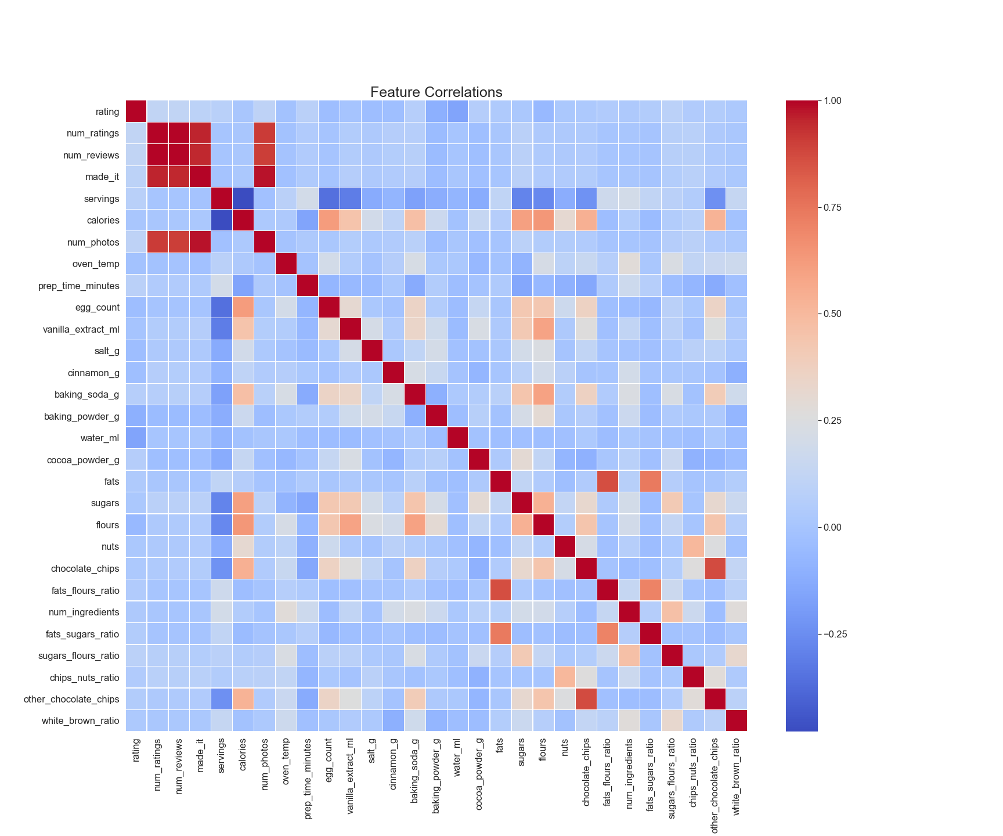
CORRELATIONS WITH TARGET VARIABLE
1.0
Absolute value of any single correlation < 16%
.75
Water: -15%
.5
Number of Photos: 10%
Fats to Sugars Ratio: 5%
.25
0
Number of Reviews: 11%
Sugars to Flours Ratio: 9%
-.25
-.5

Slide 11
LINEAR REGRESSION RESULTS

Slide 12
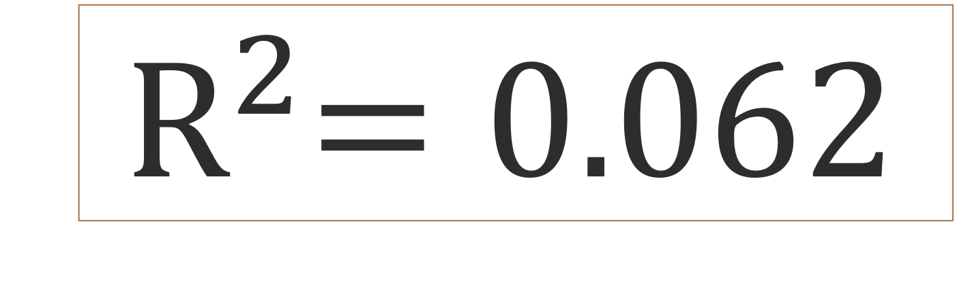
LINEAR REGRESSION RESULTS
25 Features
$${ R}^{2}=0.062$$
510 Recipes

Slide 13
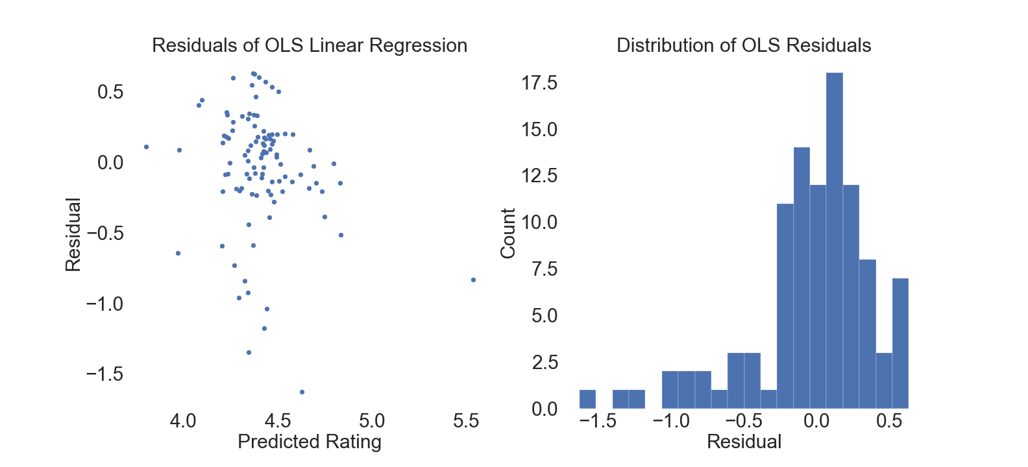
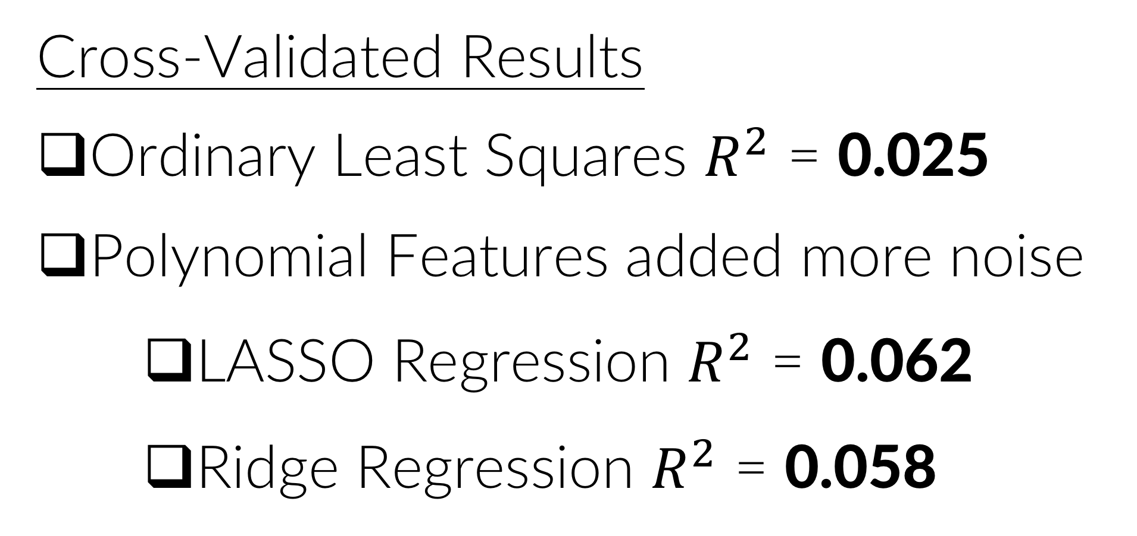
RESULTS ANALYSIS
Prediction outside range
Cross-Validated Results
Ordinary Least Squares $R^{2}$ = 0.025
Polynomial Features added more noise
LASSO Regression $R^{2}$ = 0.062
Ridge Regression $R^{2}$ = 0.058
Feature | OLS Coefficient | p-value
Eggs | -1.159 | 0.081
Vanilla Extract | 0.251 | 0.067
Baking Powder | -0.348 | 0.10
Left Skewed
Violates normality
Notes:
Was I overfitting?
More is not better!
Eggs keep a cookie together
Vanilla extract - super expensive so sure
Baking powder makes a cookie less flat and helps it raise
No features I thought would contribute did! (Ratios)

Slide 14
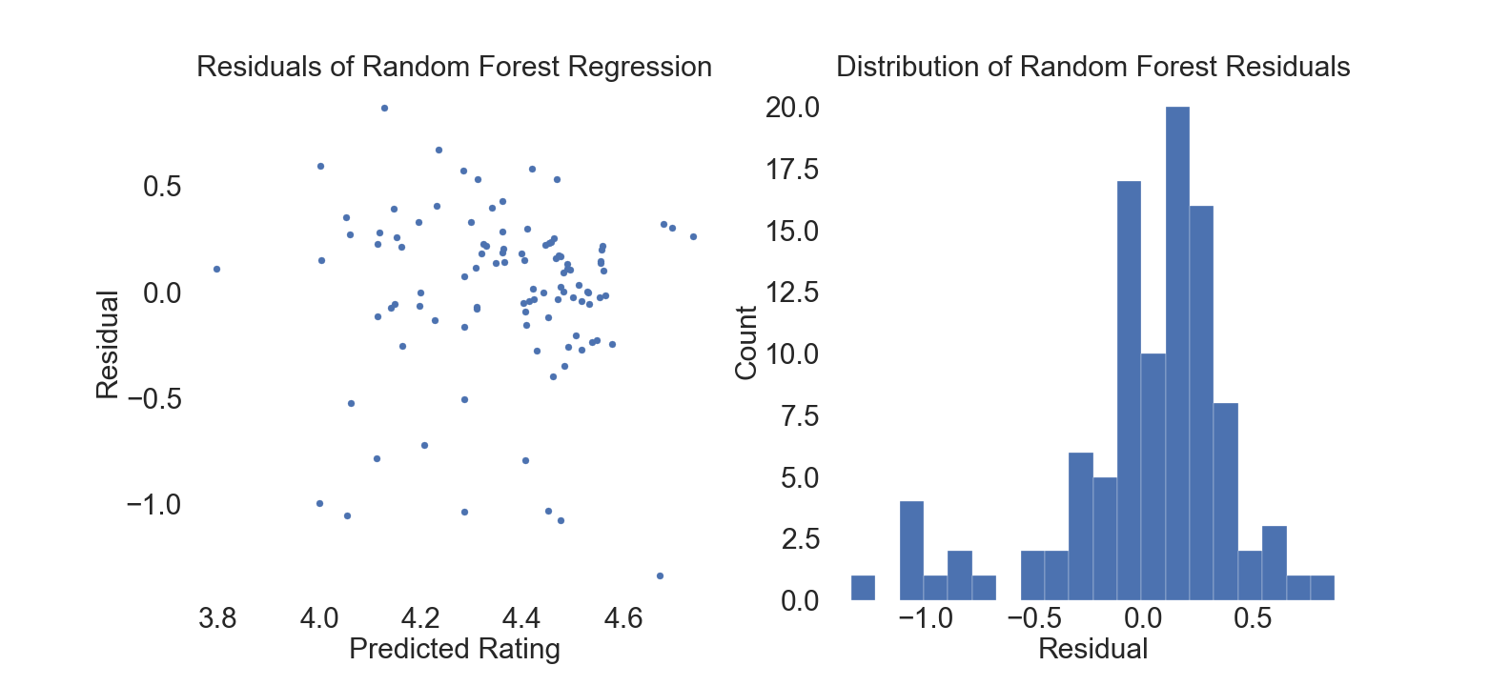


NON-LINEAR?
Random Forest Regression $R^{2}$ = 0.146
Predictions
within range
Feature | Importance
# of Photos | 0.184
Prep. Time | 0.153
Oven Temp. | 0.055
Baking Powder | 0.047
Calories | 0.046
Residuals more normally distributed
Notes:
Do these features have predictive power?
INSTAGRAM EFFECT

Slide 15
TAKEAWAYS

Slide 16
LESSON || FUTURE DIRECTIONS
1-5 scale is not continuous
Should not be calculated using simple average
Subjective in nature (user error)
Linear Regression is not a good model for predicting ratings on chocolate chip cookie recipes
Classification or other models more appropriate
Sentiment analysis/NLP

Slide 17
QUESTIONS?

Slide 18
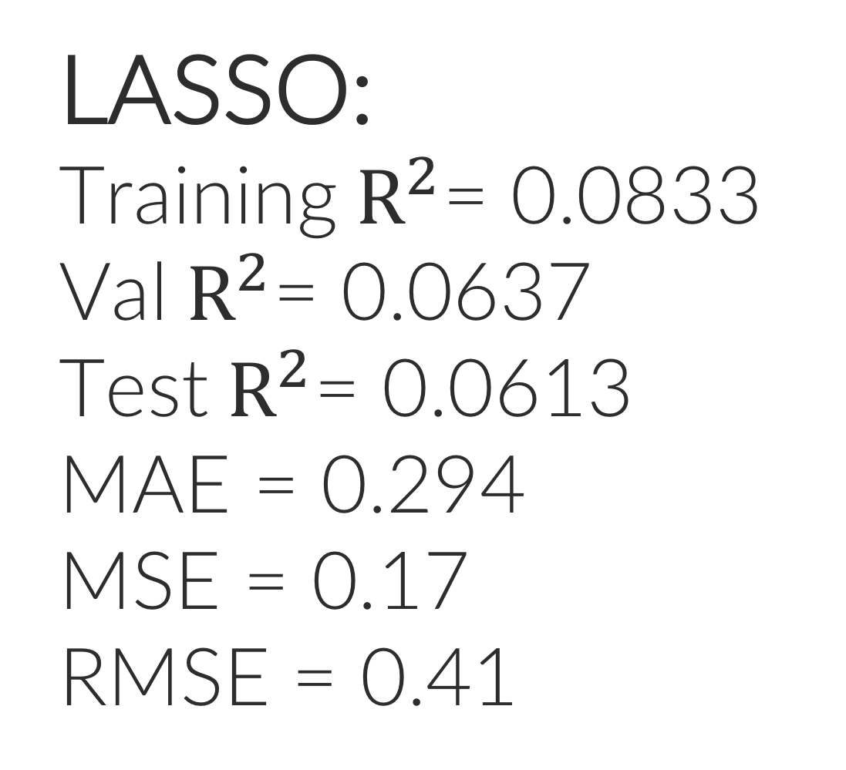
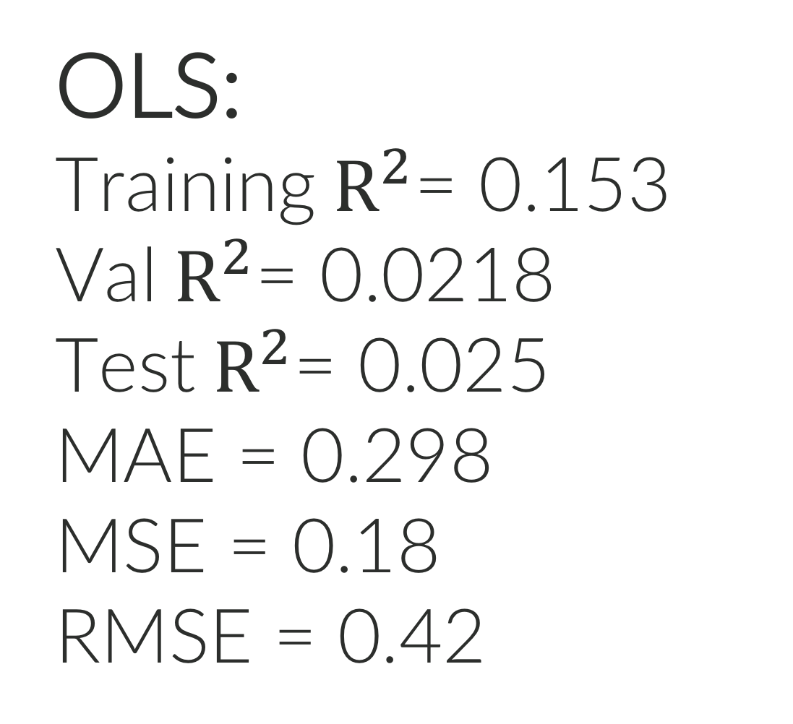
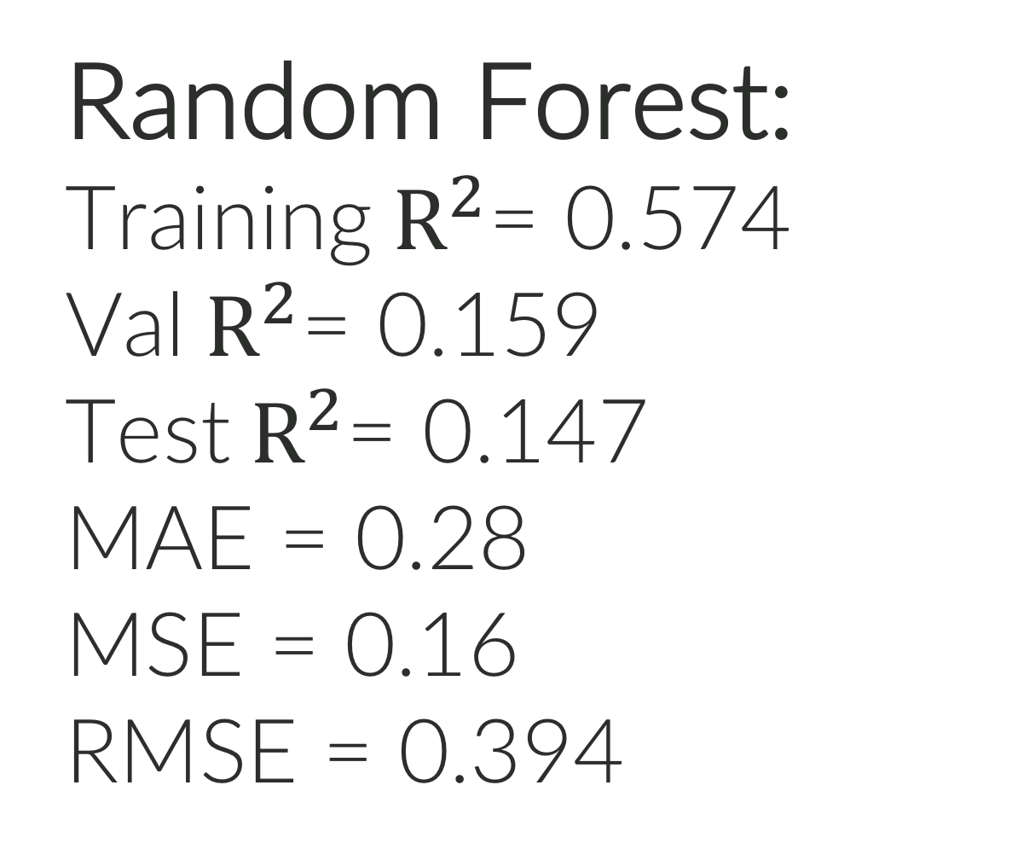
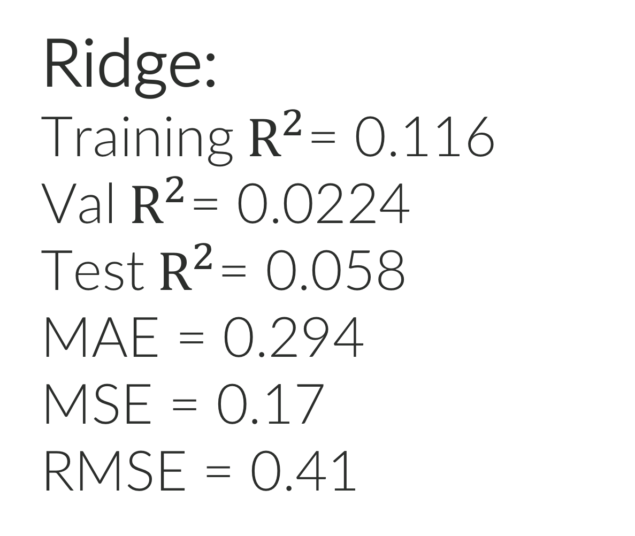
APPENDIX
OLS:
Training${ R}^{2}$= 0.153
Val${ R}^{2}$= 0.0218
Test${ R}^{2}$= 0.025
MAE = 0.298
MSE = 0.18
RMSE = 0.42
LASSO:
Training${ R}^{2}$= 0.0833
Val${ R}^{2}$= 0.0637
Test${ R}^{2}$= 0.0613
MAE = 0.294
MSE = 0.17
RMSE = 0.41
Ridge:
Training${ R}^{2}$= 0.116
Val${ R}^{2}$= 0.0224
Test${ R}^{2}$= 0.058
MAE = 0.294
MSE = 0.17
RMSE = 0.41
Random Forest:
Training${ R}^{2}$= 0.574
Val${ R}^{2}$= 0.159
Test${ R}^{2}$= 0.147
MAE = 0.28
MSE = 0.16
RMSE = 0.394

Slide 19
APPENDIX
LASSO:
alpha = 0.02479
Features selected:
Baking powder -0.0495
Photos -0.0207
Reviews -0.016
Salt -0.01
Fats/Flours ratio 0.01
Egg -0.01
Made it -0.01
Flours -0.01
Prep time 0.01
Oven Temp 0.009
Ridge:
alpha = 255.50971
Features selected:
Baking powder -0.035
Flours -0.0279
Salt -0.022
Egg -0.02
Prep time 0.0197
Servings 0.0178
Photos 0.0177
Made it 0.0166
Vanilla extract 0.0163
Oven temp 0.015
Random Forest:
n_estimators = 30
min_sample_split = 20
Features selected:
Photos 0.184
Prep time 0.129
Ratings 0.082
Reviews 0.075
Baking powder 0.047
Calories 0.046
Oven temp 0.044
Salt 0.036
Flours 0.027
Sugars/Flowers ratio 0.021

Slide 20
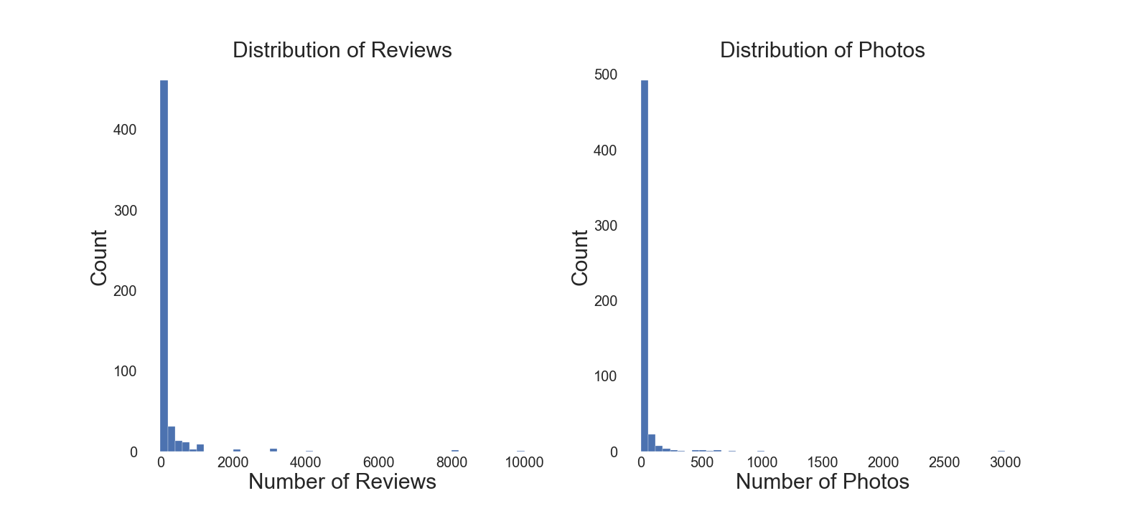
APPENDIX

Slide 21
APPENDIX
coef | std err | t | P>|t| | [0.025 | 0.975]
const | 3.9865 | 0.157 | 25.458 | 0.000 | 3.678 | 4.295
num_ratings | -0.0004 | 0.001 | -0.493 | 0.623 | -0.002 | 0.001
num_reviews | 0.0006 | 0.001 | 0.594 | 0.553 | -0.001 | 0.003
made_it | 6.305e-05 | 0.000 | 0.207 | 0.836 | -0.001 | 0.001
servings | 0.0023 | 0.002 | 1.030 | 0.304 | -0.002 | 0.007
calories | 0.0007 | 0.000 | 1.610 | 0.108 | -0.000 | 0.002
num_photos | 0.0020 | 0.003 | 0.781 | 0.436 | -0.003 | 0.007
oven_temp | 0.0004 | 0.000 | 1.198 | 0.232 | -0.000 | 0.001
prep_time_minutes | 0.0007 | 0.000 | 1.574 | 0.117 | -0.000 | 0.002
egg_count | -1.1581 | 0.661 | -1.753 | 0.081 | -2.459 | 0.142
vanilla_extract_ml | 0.2500 | 0.136 | 1.841 | 0.067 | -0.017 | 0.517
salt_g | -0.1156 | 0.095 | -1.219 | 0.224 | -0.302 | 0.071
cinnamon_g | -0.1212 | 0.779 | -0.156 | 0.876 | -1.654 | 1.412
baking_soda_g | 0.3488 | 0.364 | 0.958 | 0.339 | -0.368 | 1.065
baking_powder_g | -0.3481 | 0.211 | -1.647 | 0.101 | -0.764 | 0.068
water_ml | -0.0430 | 0.052 | -0.830 | 0.407 | -0.145 | 0.059
cocoa_powder_g | 0.0228 | 0.032 | 0.703 | 0.483 | -0.041 | 0.087
fats | -0.0004 | 0.001 | -0.436 | 0.663 | -0.002 | 0.001
sugars | -0.0048 | 0.007 | -0.710 | 0.478 | -0.018 | 0.008
flours | -0.0167 | 0.007 | -2.243 | 0.026 | -0.031 | -0.002
nuts | -0.0060 | 0.014 | -0.444 | 0.658 | -0.033 | 0.021
chocolate_chips | -0.0043 | 0.008 | -0.519 | 0.604 | -0.021 | 0.012
other_chocolate_chips | 0.0096 | 0.009 | 1.122 | 0.263 | -0.007 | 0.027
num_ingredients | 0.0086 | 0.012 | 0.721 | 0.472 | -0.015 | 0.032
fats_flours_ratio | 0.0050 | 0.007 | 0.738 | 0.461 | -0.008 | 0.019
fats_sugars_ratio | 0.0010 | 0.003 | 0.301 | 0.764 | -0.006 | 0.008
sugars_flours_ratio | 0.0353 | 0.047 | 0.752 | 0.453 | -0.057 | 0.128
chips_nuts_ratio | 0.0009 | 0.011 | 0.081 | 0.935 | -0.021 | 0.023
white_brown_ratio | -0.0624 | 0.051 | -1.215 | 0.226 | -0.164 | 0.03
Dep. Variable: | rating | R-squared: | 0.153
Model: | OLS | Adj. R-squared: | 0.068
Method: | Least Squares | F-statistic: | 1.792
Date: | Thu, 18 Apr 2019 | Prob (F-statistic): | 0.0101
Time: | 20:15:59 | Log-Likelihood: | -157.25
No. Observations: | 306 | AIC: | 372.5
Df Residuals: | 277 | BIC: | 480.5
Df Model: | 28
Covariance Type: | nonrobust
Omnibus: | 60.507 | Durbin-Watson: | 1.884
Prob(Omnibus): | 0.000 | Jarque-Bera (JB): | 108.754
Skew: | -1.078 | Prob(JB): | 2.42e-24
Kurtosis: | 4.970 | Cond. No. | 1.83e+04

Slide 22
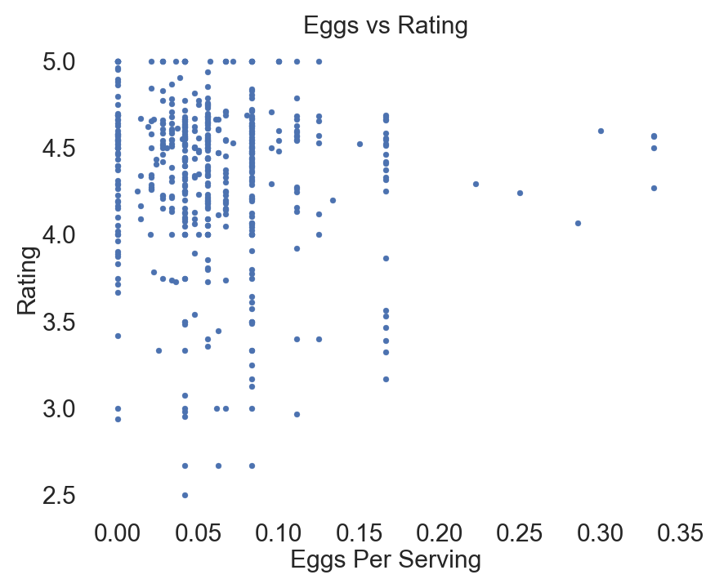
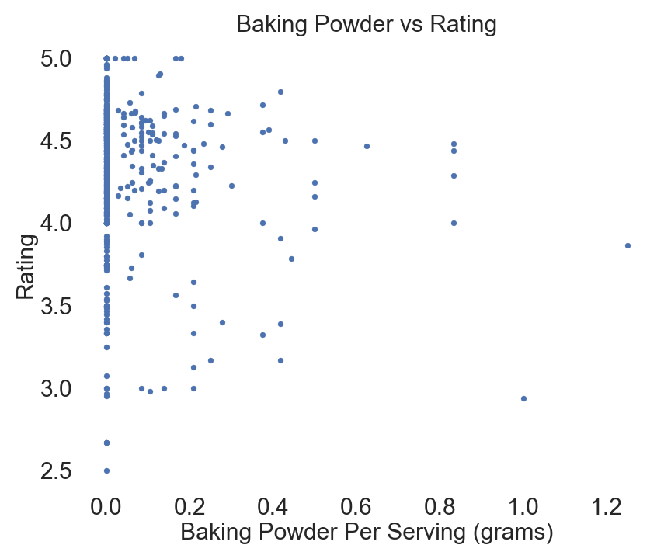
APPENDIX

Slide 23
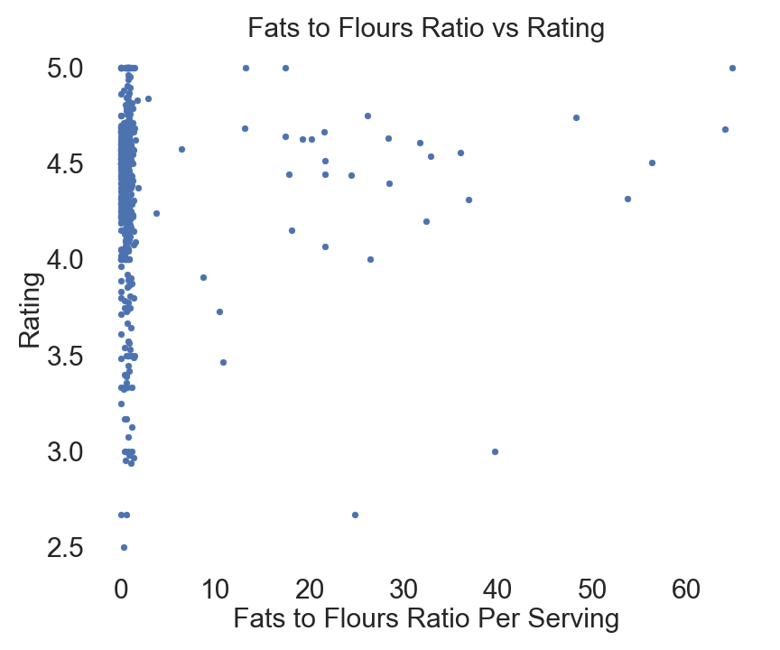
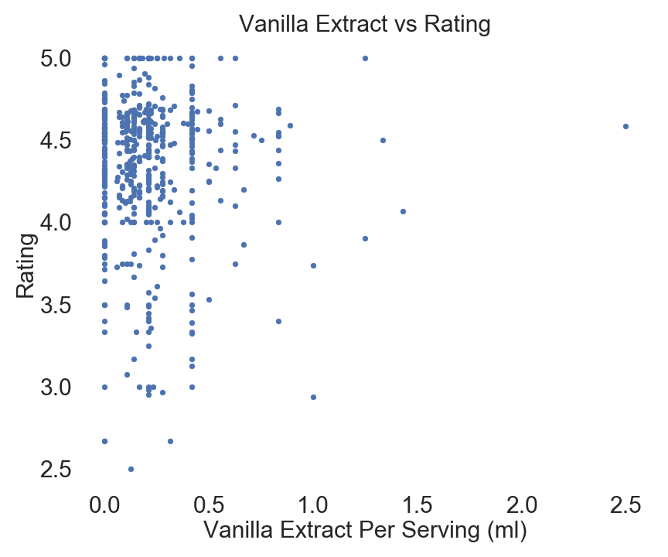
APPENDIX

Slide 24
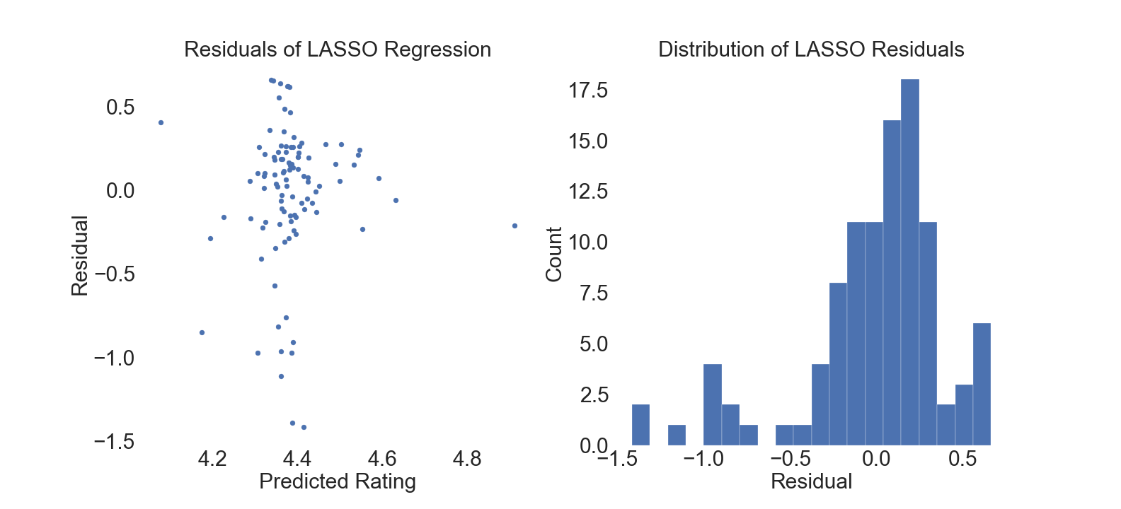
APPENDIX

Slide 25
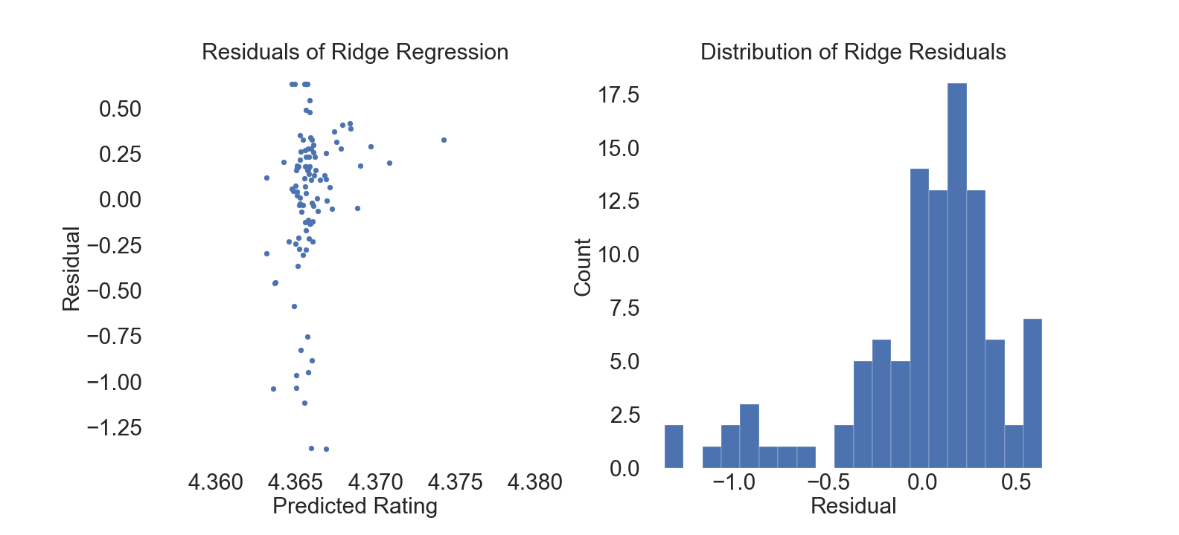
APPENDIX

